Slide 1







MyData 2016 – Helsinki, Sep. 1st 2016
Michele Vescovi
TIM – Telecom Italia
SKIL Joint Open Lab (Trento - Italy)
Experimenting a user-centric paradigm
for personal data-driven services
My Data Store, the Mobile Territorial Lab & LivLab
Main Partners:
Suppored by:

Slide 2
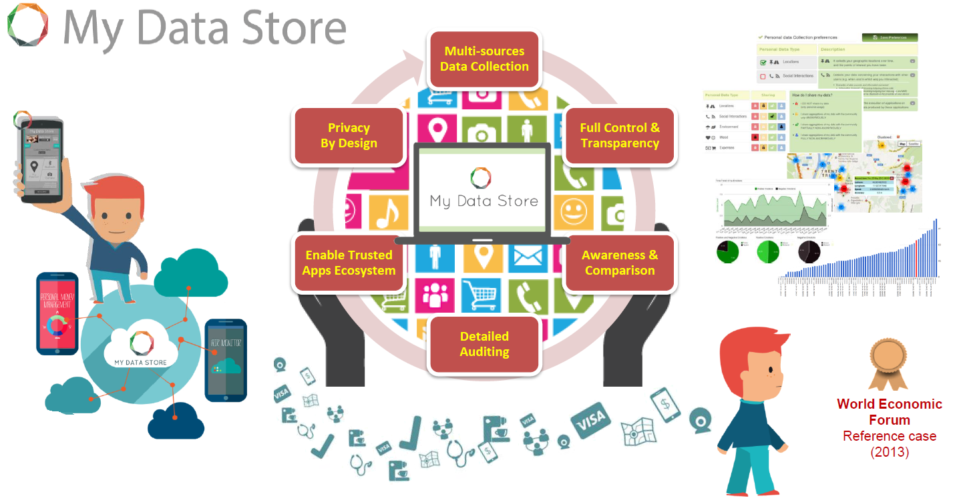
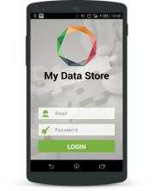
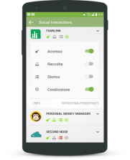
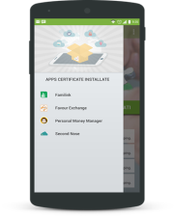
An Eco-System of Trusted Services with User Control & Transparency

