Slide 1
IoT & Thing2Data, MyData perspective
Risto Linturi, Chairman, Sovelto Plc

Slide 2
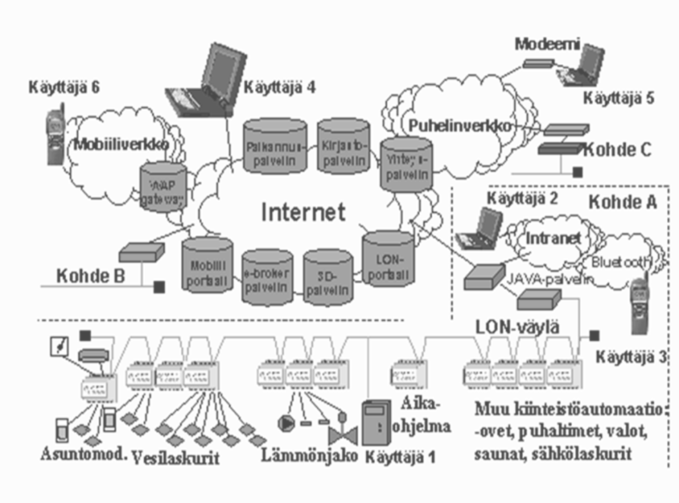
What are we talking about – what is IoT?
Devices have been connected to the Internet for a long time, term was M2M
Helsinki Arena 2000 spinoff from the 1990s in the Figure– COBA by Lonix
→
Industrial Internet
Internet of Things
Internet of Everything
→
→
What has changed?

Slide 3
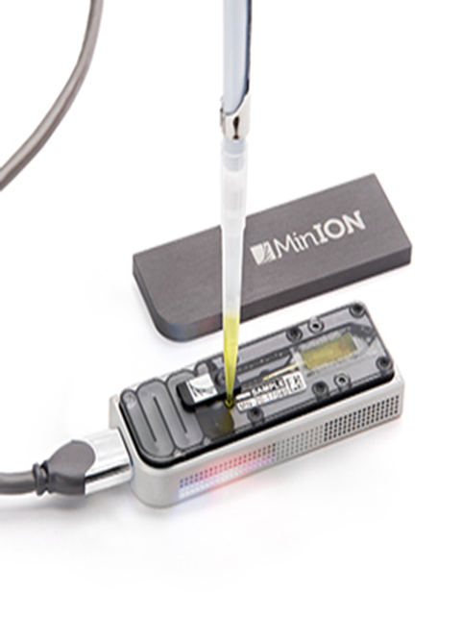
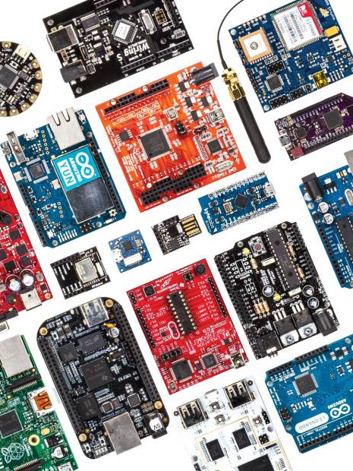
The development of smart devices has become common and easy!
A comparison of 36 microcontrollers http://makezine.com/magazine/make-36-boards/which-board-is-right-for-me/
Raspberry Pi, Arduino, etc.
Partly open source
good development tools
Linux, Windows 10 available
Widely available add ons: Wi-Fi, GPS, USB, etc. additional modules and device controllers required for robotics
The price level varies from a few euros to a few dozen euros
→
→
→

Slide 4
Other development speeding up IoT
More and more devices and measuring equipment are online
Mobile devices contain an increasing number of sensors, crowdsourcing
Service robotics is increasing rapidly
Open data, especially GIS data, is increasing
Big data, artificial intelligence and cloud services are becoming stronger
The automation of logistics, heterogeneous containers
Changing devices into services, remote diagnostics
The possibility of using information with smart devices has improved

Slide 5
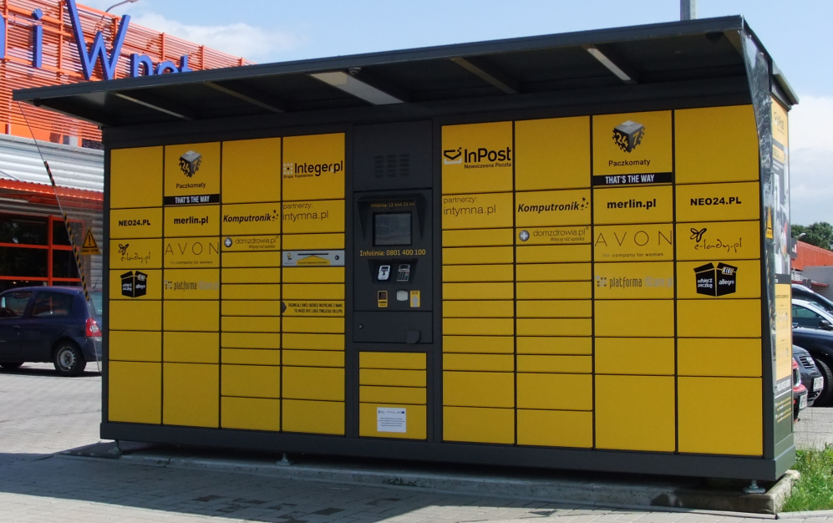
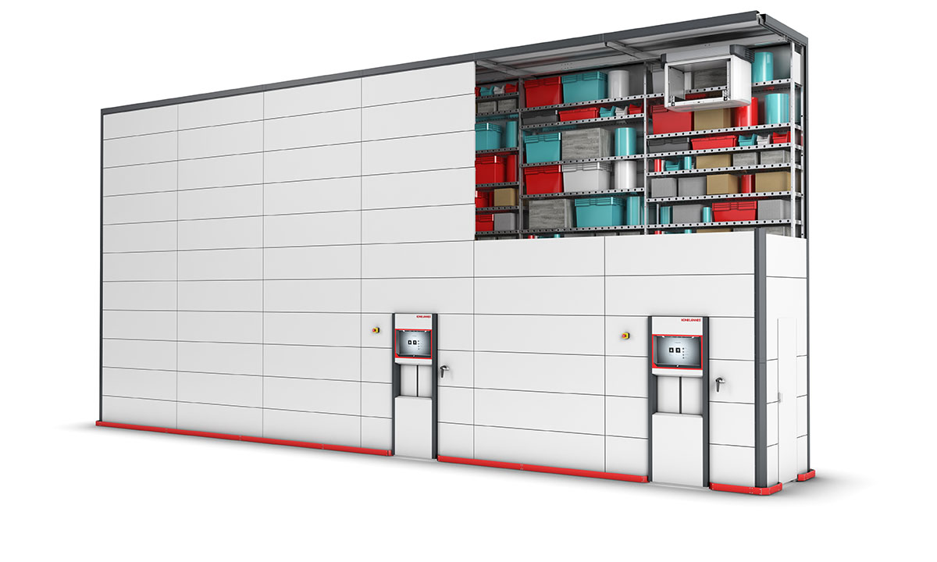
Example:Open logistics Cars as delivery boxes (Volvo)
We could have a delivery box in every suburb in walking distance to every home – anyone could leave stuff there and pick it up with a predefined code
If cars were delivery boxes and the courier had location data of the car and a temporary key to the trunc – it would be like Volvo&DHL

Slide 6
How does MyData relate to individual things
IoT originally didn’t mean devices that communicate over internet
When individual things can be identified, it does not actually make difference whether the thing is connected or the cellphone and whether the thing has software or the cloud
I will talk about the problems and solutions concerning MyData when there is data, which concerns individual things
Such MyData examples are easy where things are not individualized and each part of mass data concerns one person
Data on individual things very often relates to transactions between two or more people in different roles
Several people usually have right to some shared and some private parts of data that may be produced real time.

Slide 7
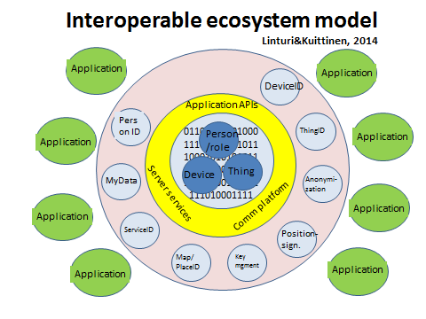
Ecosystem architecture (Traffic Data Visions, LiVi 42/2014)
Implementation in the Thing2Data project
Devices, objects and people have a unique identity in an ecosystem
The identity is either private or public, and it can easily be anonymised
The joint services of an ecosystem enable the exchange of information between applications
→
→
→

Slide 8
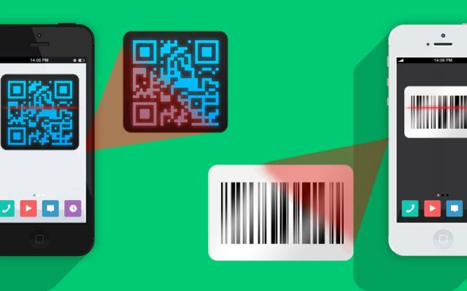
The Internet of Things – a point of view to IoT
Each object has a unique identity in the Thing2data cloud
This enables an enormous number of new services and devices, and the system will grow incrementally!

Slide 9
Application visions: Thing2Data – removes hassle!
Imagine: you buy a coffee cup from an online store
The cup is placed in the slot for outbound objects and you will be identified as the new owner of the cup in the Thing2Data information.
Your MyData supplies the default delivery method, payment method, etc. for logistics. Consignment notes, address labels, receipts, etc. are all Thing2Data bits.
Coffee machine will identify your cup and by default, prepare your coffee as you prefer it.
Imagine: a manufacturer notices a fault in a food product you have bought
The manufacturer marks an alarm in the Thing2Data information of the faulty batch of food products. The product you have bought informs you of the matter.
The manufacturer does not have to identify the buyer – data security is OK!
Imagine: you order supplies for a building
A CAD system submits a parts list as Thing2Data.
A supplier uses the orderer's identifiers as Thing2Data.
When the orderer receives the objects, ThingData includes all CAM/ERP data for your own object logistics

Slide 10
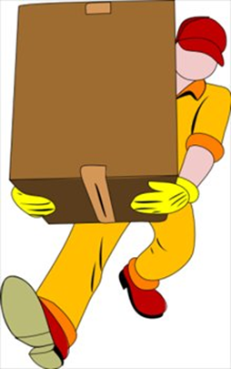
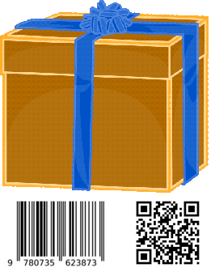
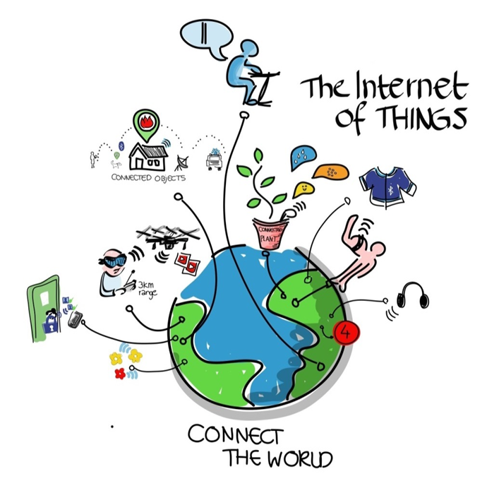
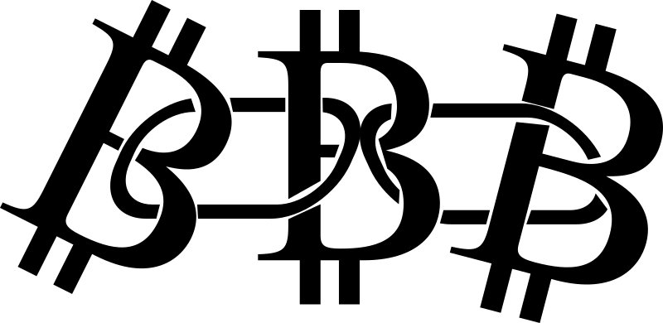
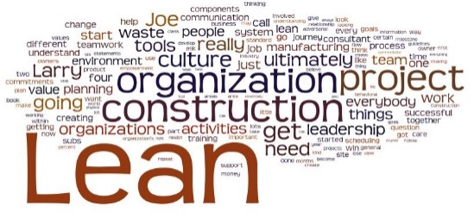
Thing2Data architecture
Individual identifier
Mobile applicat.
Standardised data and application interface
Inventory address
Blockchain
Identitty
issuer
Thing2Data inventory
services
eetIdentit Isssuer
Business applications
Ident
iteetiIssuer

Slide 11
Thing2Data rights & roles
Thing X can have a role in Thing Y allowing it to access certain attributes Thing Y can have a role in Thing Z allowing both Thing X & Y to access some attributes in Z
Thing2Data has also a system for service transactions allowing Things to hide data and still i.e. perform alarms, log services required and performed
Thing X
Roles
Role access rights
Thing Y
Roles
Thing Z
Attributes
Role access rights
Roles
Role access rights
Attributes
Attributes

Slide 12
Interaction between Thing2Data servers
Server API is open and anyone can set up a Thing2Data server
Things can be moved from one Thing2Data server to another
ID’s can be issued by any Thing2Data server
ID’s can be published to become universal through Blockchain
Access rights can span from things in one inventory to another
Thing2Data solves several problems in MyData applications
Independency of trusted 3rd party or service provider
Structure of data and access rights when dyadic transactions
Logging, security and trust
Structure of generic thing-related & service related MyData
Application interface

