Slide 1
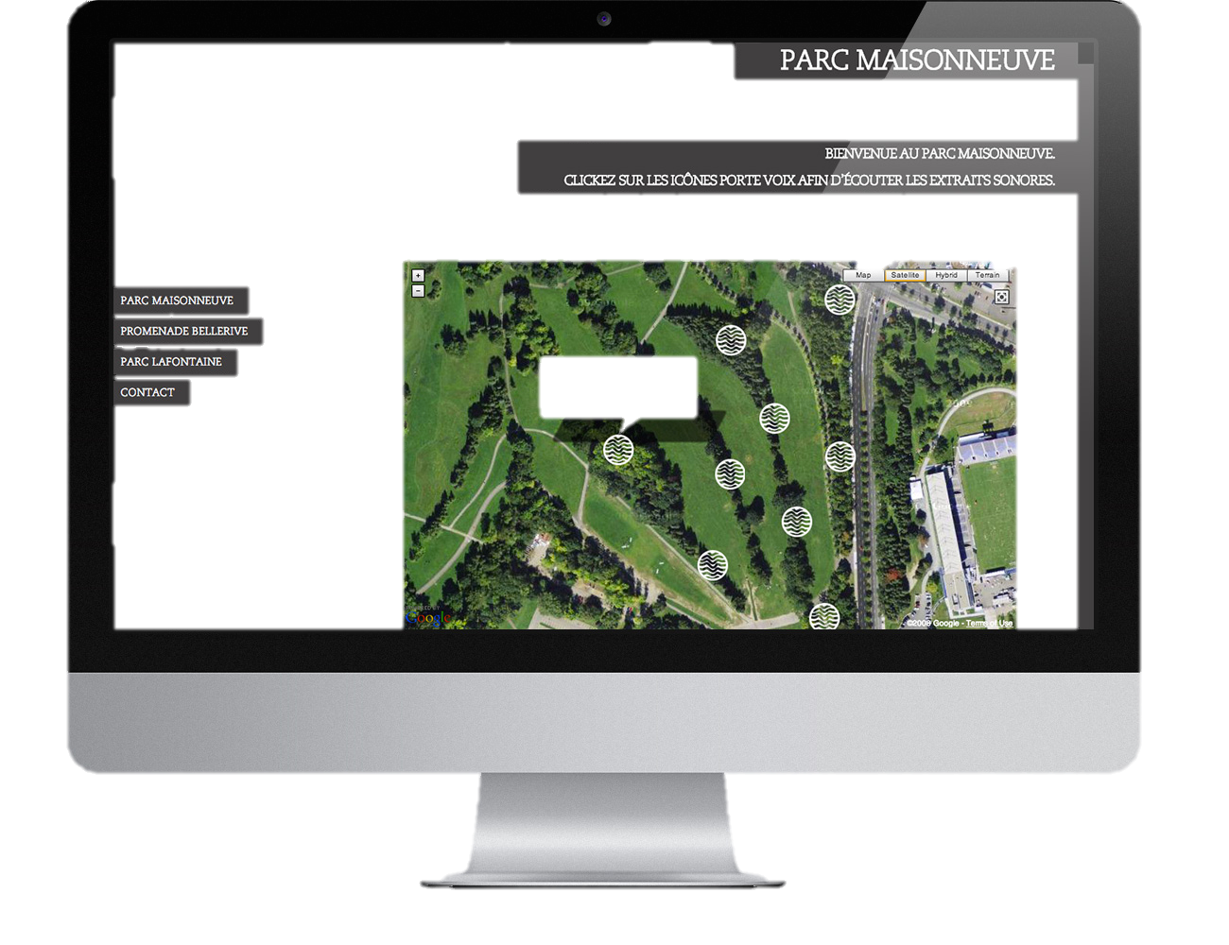
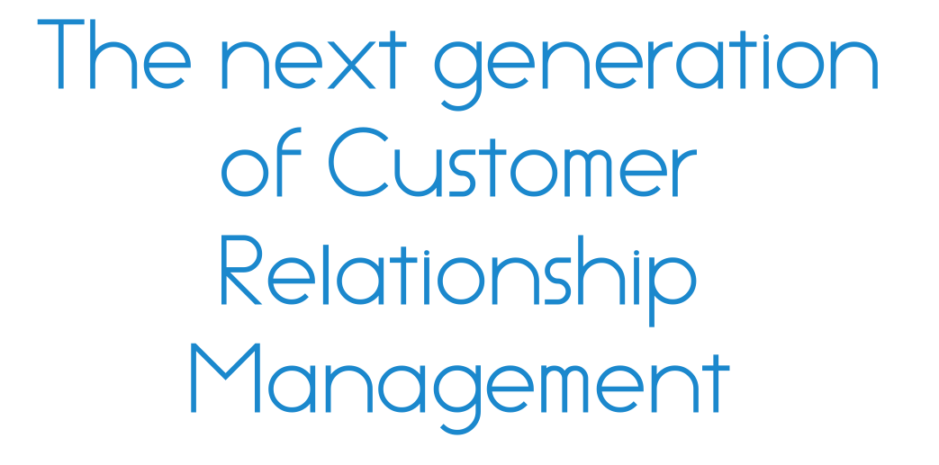
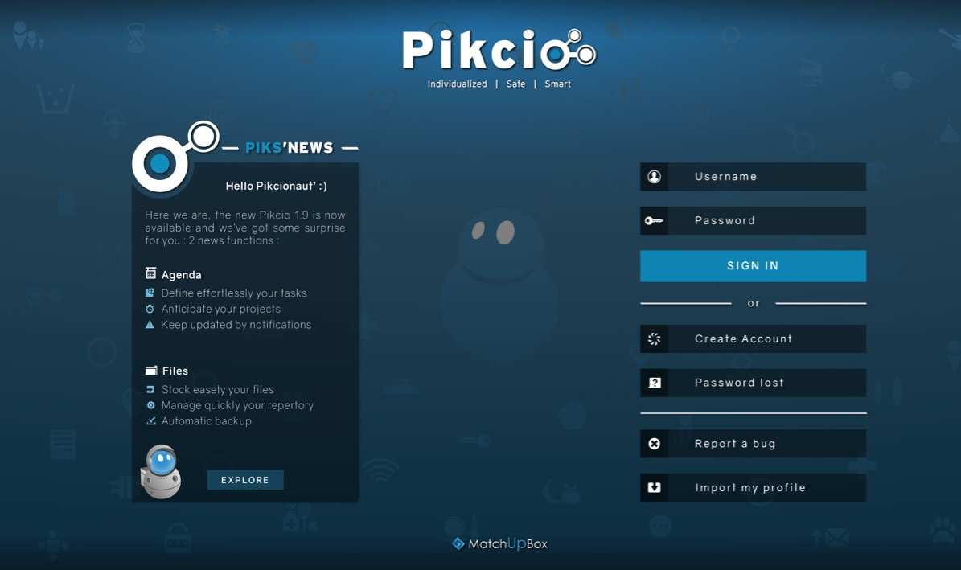
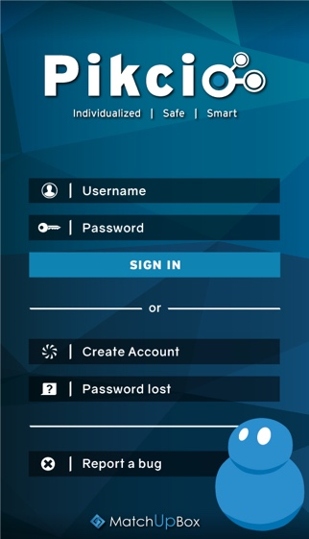
www.matchupbox.com

Slide 2
Finance industry: Challenges of the 3.0 customer relationship
Investments in secure portal & app
Communication ATAWAD
Tailored offer
Transparency, Ethics
Customer deep knowledge
Brand image
Reaching a plateau: new customer’s expectations aren’t meet
Accuracy & actualization of data
Competitive advantage
Data security
Customer Experience
Loyalty
Notes:
Bank & insurance must provide more & more tailored offer but in order to do so thhey must have customers’ accurate data while being able to ensure the security of these data. Today consumers have several banks accounts and companies experience a poor loyalty from them. Customers

Slide 3
Company Side
Smart customer relationship
Build the 3.0 Customer relationship
Decrease process costs
Qualitative customers relationship
Real time communication & sharing
Smart scheduling
Accurate & actualized data
AI automates process
(smart contract)
Data under users’ control
Trust relationship
Loyalty
CX

Slide 4
Company Side
Smart offer matching
Boost your sales: new source of revenue
Decrease process
& intermediaries costs
Smart & non intrusive prospection
Match your offer with Pikcionautes’ needs
Qualified profiles
Decrease on-boarding costs
Strong authentication & identification process
AI automates process
(smart contract)
Business ethics
ROI optimisation
Notes:
Boost your sales – New revenue source – non intrusive for customer

Slide 5
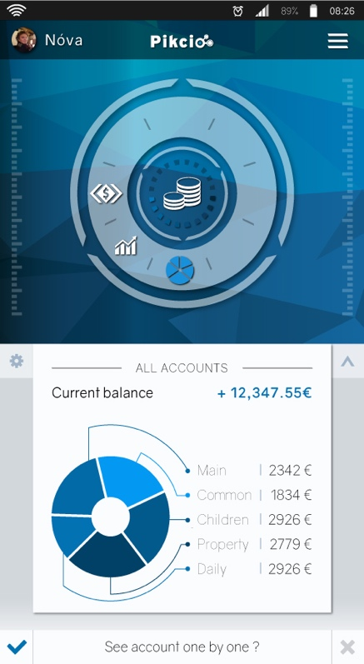
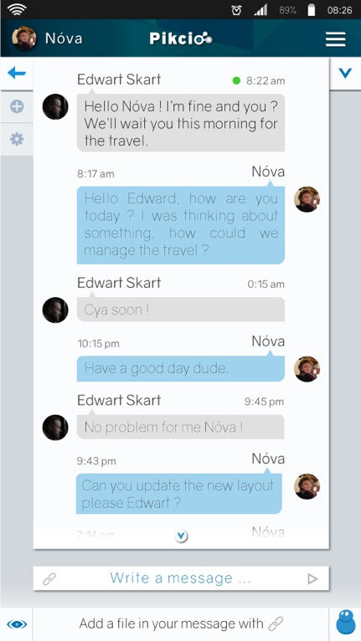
End-user side
A ONE-STOP APP
Link & classify data from many sources
Secure and interactive messaging

Slide 6
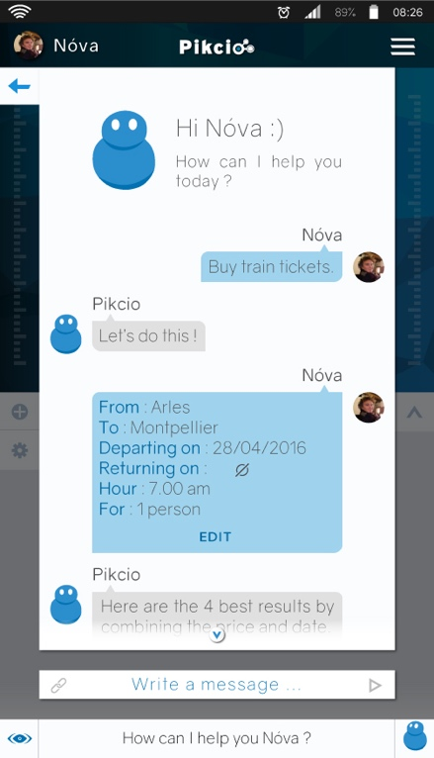
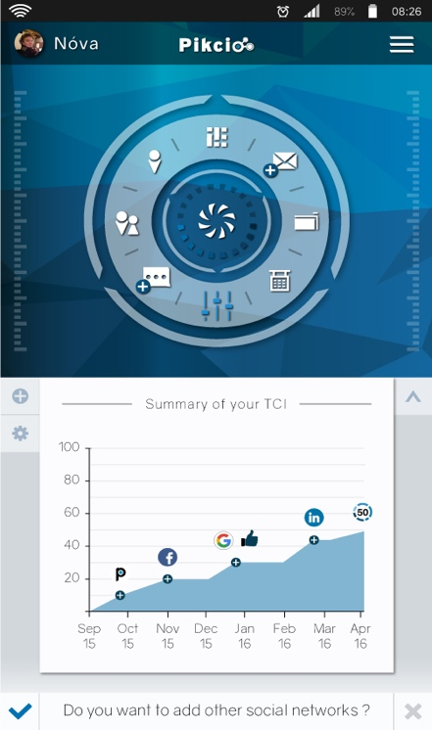
End-user side
A SECURE APP
A SMART APP
Smart searches based on available data and preferences
(Artificial intelligence)
Data under users’ control
Permission-based data access
Trust score
(My Trust Capital Index)
Trust relationship
Automatic form filling (chatbot)

Slide 7
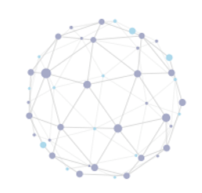
A strong technological base
MatchUpBox Network
3 years of R&D
Immediate compliance with personal data regulations
Highly scalable
Strong authentication & Identification process
Peer2Peer decentralized Network
(Blockchain)
Hacking risks removed
Secure environment
No data stored on central server
Data Encryption & anonimization
Notes:
Advantages for GAN:
A smart app
Communicate with your customers in real time
Allowing you to have a more qualitative customer relationship and increase their satisfaction
Develop and launch smart contracts
Decrease your prospection costs and optimise your ROI
A secure app
Strong Authentification: increase your KYC rate
The app uses our decentralised network based on blockchain principle
No data are stored on server or cloud: all are in the devices of users
Full process of data encryption

Slide 8
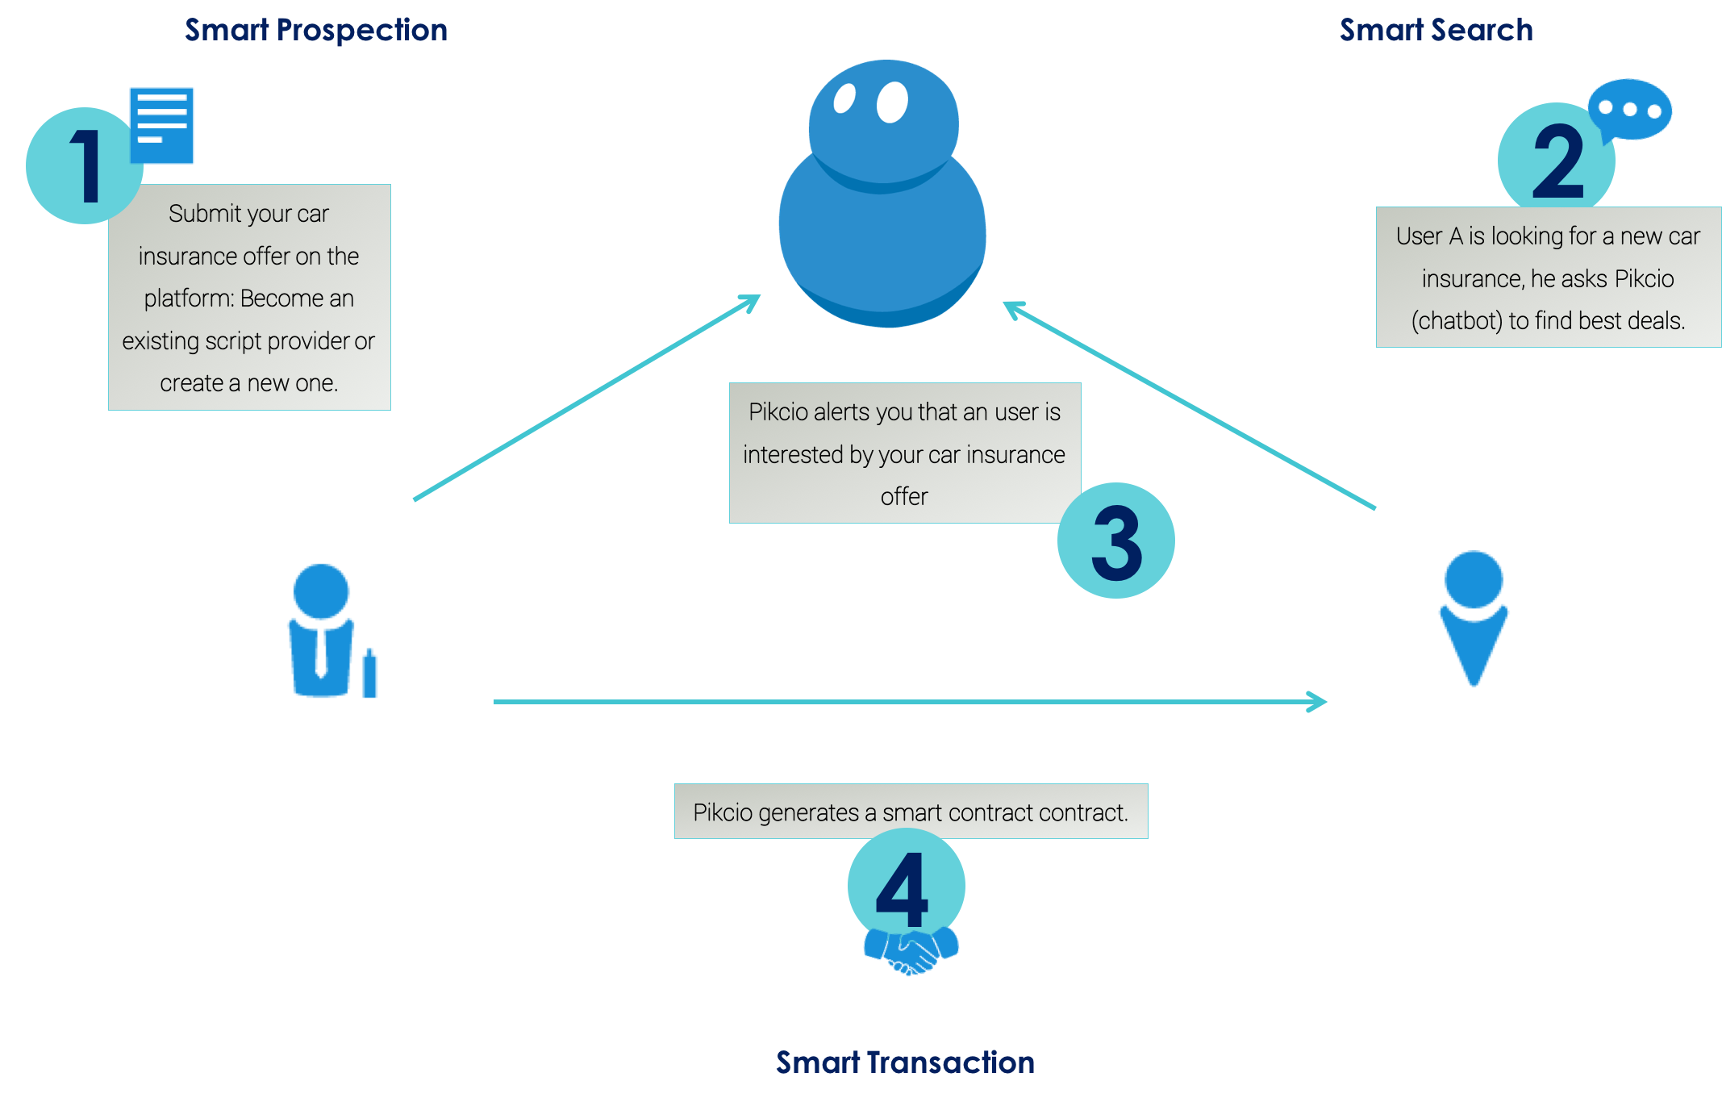
Use case: Insurance

Slide 9
The Founders team
Didier Collin de Casaubon,
Founder & CEO
Post Grad in Philosophy, Mathematics, Master HEC Business School
Serial entrepreneur (software industry)
17 years in the Finance and Banking Industries, both in Europe and the US
Fabien Bucamp,
Engineering
Telco Engineer
8 years at the French Department of Defense as Project manager then Team Manager for the Networks Security.
Pauline Feaugas,
Operations & Corporate Dev.
EMBA Montpellier Business School
14 years in the software industry, especially with start-ups: development, operations, partnership, financing.
Caroline Dumortier,
Business Dev. North -America
MSc in Management (HEC) & Masters Degree in Business Law (Sorbonne)
4 years of North American experience: creation of a French subsidiary, team management
Jorick Lartigau, PhD
R&D
PhD in Computer Science from Harbin Institute (China) and Msc from Bordeaux University.
Specialist in Data Security and Big Data algorithms
And: Clara, Florian, Affef, Alizon, Ghislain, Pierre, Hugo, Loïc (developers, marketing, sales. operations)
Supported by Scientific & Executive Committees with deep technology and strong business expertise.

Slide 10
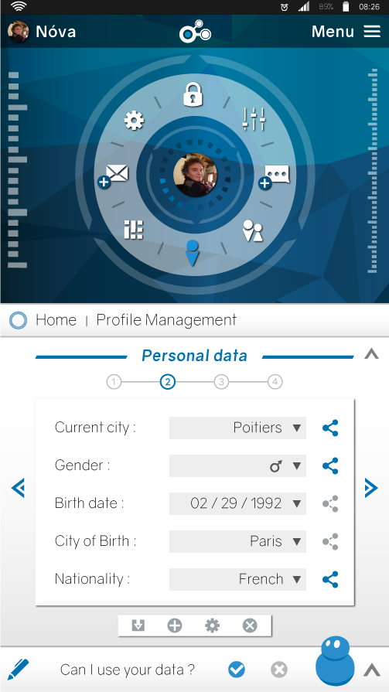
Download Pikcio Now
www.matchupbox.com
Clara Schmitt +33 677 369 940 clara.schmitt@matchupbox.com MatchUpBox SAS Rond-Point Benjamin Franklin,
Caroline Dumortier +1 617 712 8034 caroline.dumortier@matchupbox.com MatchUpBox Inc 50 Milk street, 16th floor,

Slide 11
All in all…
Access to accurate & actualized data
Strong user identification and authentication
KYC(S) (Know & Serve your customer) optimized
Better customer knowledge
Artificial Intelligence, chatbot
Process automation (smart contract)
Boost sales thanks to smart matching
Decrease on-boarding costs
Intermediaries and process costs reduction
Immediate compliance with international regulation on personal data protection
Highly secure environment
Hacking risks removed
Personal data storage costs reduces
Easy to implement
Sync with existing CRM solution
Client Pull
Customer Managed Relationship

Slide 12
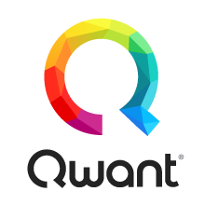
CLIENTS AND STRATEGIC PARTNERSHIPS
E-health
Banks / Fintech
Energy
Insurance
Retail
Institutional
Telcos-Internet
Notes:
Aviitam: intégration de leur app dans Pikcio
Voluntis: paramedical: collectent data pour recherche et souhaitent les anonymiser → Safe2Net
Ihealth: paramedical: IoT: intégration de leur app dans Pikcio
Bewell: paramedical: IoT: intégration de leur app dans Pikcio
United Healthcare: collecte data d’assurance → Compliance pour anonymisation → Safe2Net
Orange Health: Pikcio+Safe2Net
Impulse Brussel: Hackathon Esanté – on y participe en octobre
Transferts LR + Pôle innovation de la Region LR: utilisation Pikcio interne
Staples: Utilisation Pikcio dans RH : interne + externe dans processus de recrutement
Adeo: Mission de réflexion concernant la loi UE 2018

Slide 13
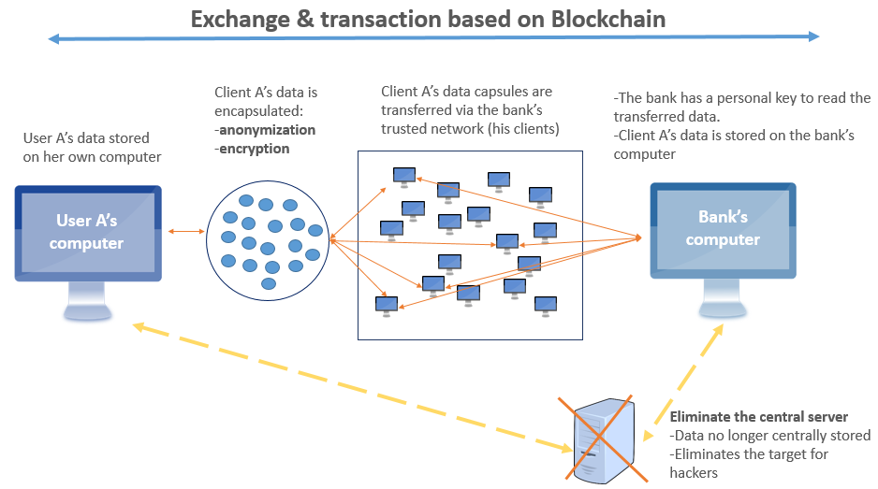
THE TECHNOLOGY: Blockchain

